Slide 1
Radio Frequency Signal Generator
By: Ethan Cura, Abel Gonzalez, Joseph Hinz and James Taylor
Notes:
James

Slide 2
Purpose
The goal of this project is to supplement the existing market with a low-cost RF signal generator for students and enthusiasts.
Notes:
James

Slide 3
Technical Summary
The signal generator shall have a frequency range between 1 and 500MHz with 1Hz precision.
The signal generator shall be able to frequency and amplitude modulate this carrier frequency.
The signal generator shall minimize any spurious signals for a spectrally pure output.
Notes:
Abel

Slide 4
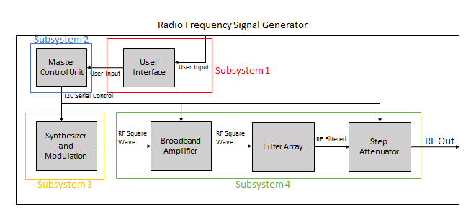
System Overview
Subsystem 1: Ethan Cura
Subsystem 2: Abel Gonzalez
Subsystem 3: Joseph Hinz
Subsystem 4: James Taylor
Notes:
Ethan

Slide 5
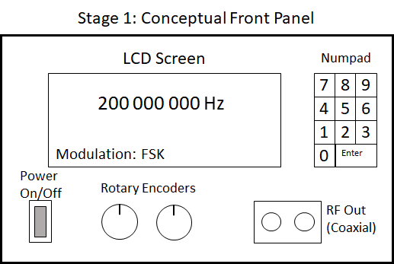
Subsystem 1: User Interface

Slide 6
Subsystem 1: Integration Goals
Buy a simple metal housing to mount instruments
Split UI into 2 boards(UI board/MCU board) for easier integration
Redesign UI board to allow UI elements to mount to the front panel
Design MCU board that interfaces with the LaunchpadXL and connect the MCU board to the UI board and all subsystems
Design the MCU board to distribute power to all other boards

Slide 7
Subsystem 1: Integration Progress
A metal housing has been purchased and delivered
Both boards have been received from fabrication
Boards have been assembled and work as intended
Case fitting/mounting is currently in progress

Slide 8
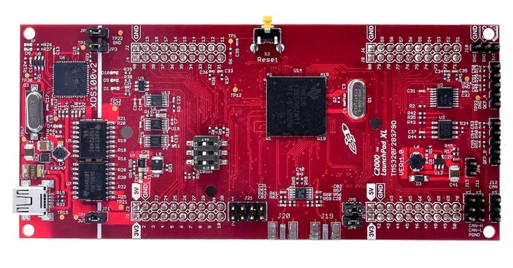
Subsystem 2: Master Control Unit
Notes:
Controls the synthesizer, modulation, filter selection, and appropriate attenuation
Abel

Slide 9
Subsystem 2: Integration Goals
Develop code that will allow the MCU to interface with digital I/O such as the rotary encoders and numpad
Develop code that will allow the MCU to communicate/control I2C components such as the character display and synthesizer
Develop a menu that allows the user to control the completed device through the UI

Slide 10
Subsystem 2: Integration Progress
Code has been developed to communicate with all the other subsystems and their components
We have begun developing a menu system that allows the user to control the instrument through the numpad

Slide 11
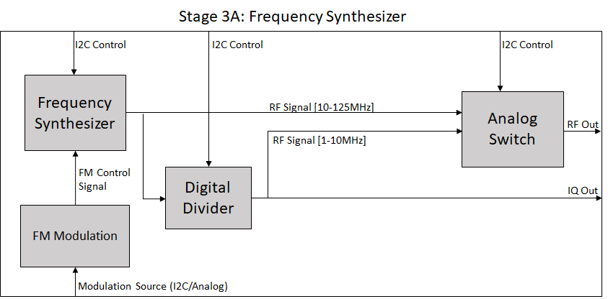
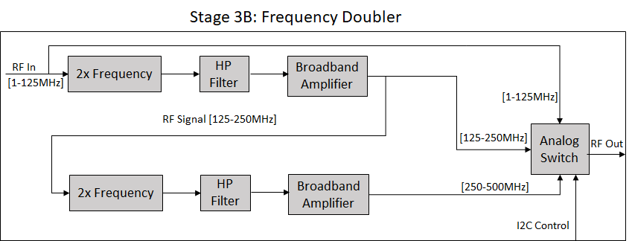
Subsystem 3: Synthesizer and Modulation
Notes:
Joe

Slide 12
Subsystem 3: Integration Goals
Subsystem 3 will be controlled via I2C through a ribbon cable from the MCU board
Power will also be supplied from the MCU board
The output of subsystem 3 will be passed to Subsystem 4 through a coaxial cable

Slide 13
Subsystem 3: Integration Progress
At this point Subsystem 3 works as intended
Communication through I2C has been tested successfully on our new MCU
Output frequency has been calibrated for improved accuracy

Slide 14
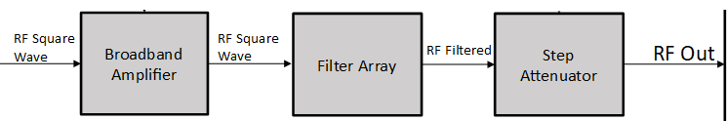
Subsystem 4: Broadband Amplifier/Filter Array/Step Attenuator
Amplifier increases the power of the carrier/modulated signal
Filters remove unwanted harmonics from square wave signal to produce a sinusoidal carrier
Attenuators reduce signal power to the user defined output power
Notes:
James

Slide 15
Subsystem 4: Integration Goals
Subsystem 4 will be controlled via I2C through a ribbon cable from the MCU board
Power will also be supplied from the MCU board
The output of subsystem 4 a coaxial terminal

Slide 16
Subsystem 4: Integration Progress
All boards fabricated and assembled (with minor exceptions)
Filter and attenuator boards working as expected at frequencies <180MHz
Filter and attenuators boards not working at frequencies >180MHz
I2C control has been tested on multiple boards
Notes:
James

Slide 17
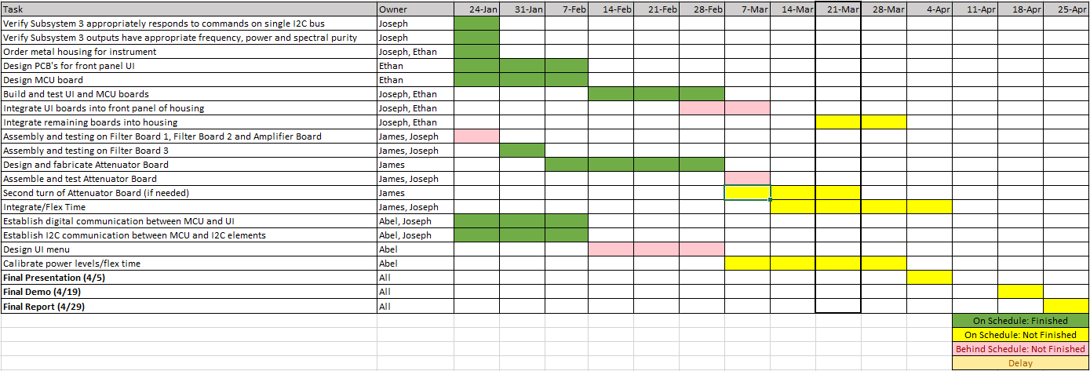
Integration Timeline

Slide 18
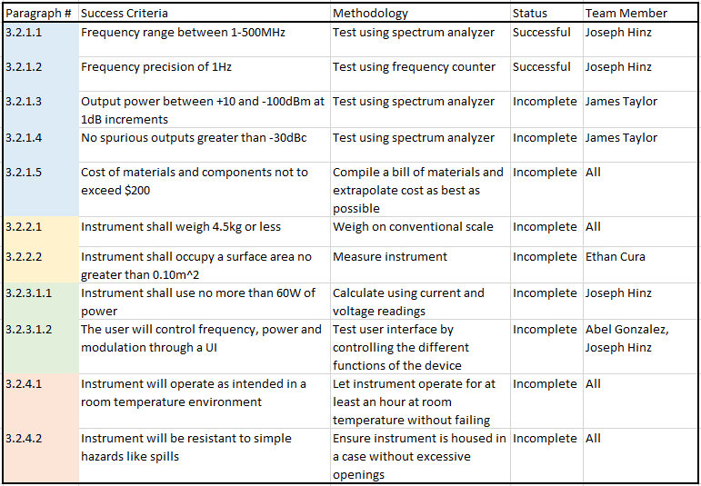
Validation Plan

Slide 19
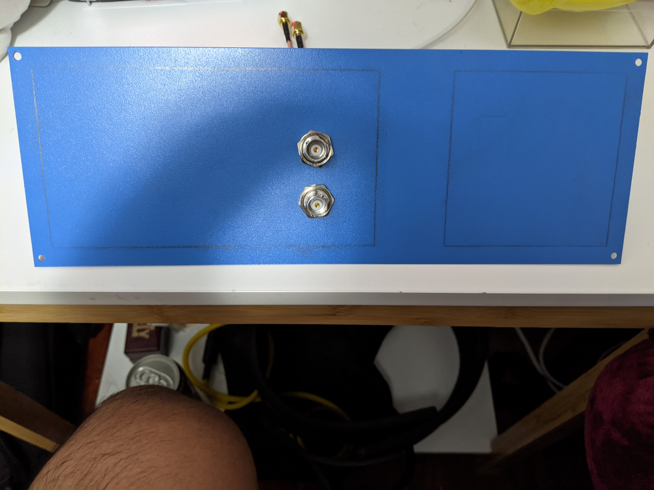
Front Panel of UI

Slide 20
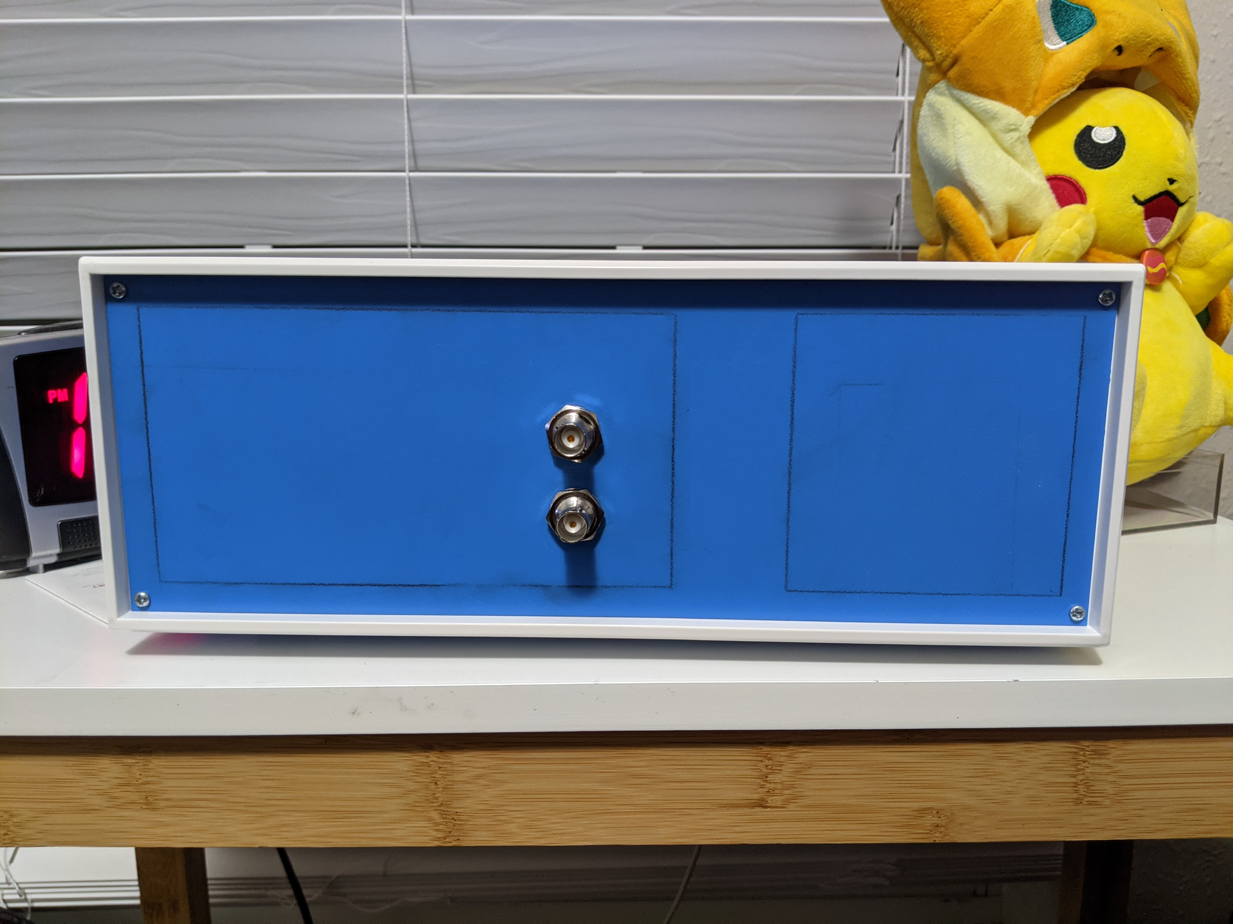
Housing with Front panel

Slide 21
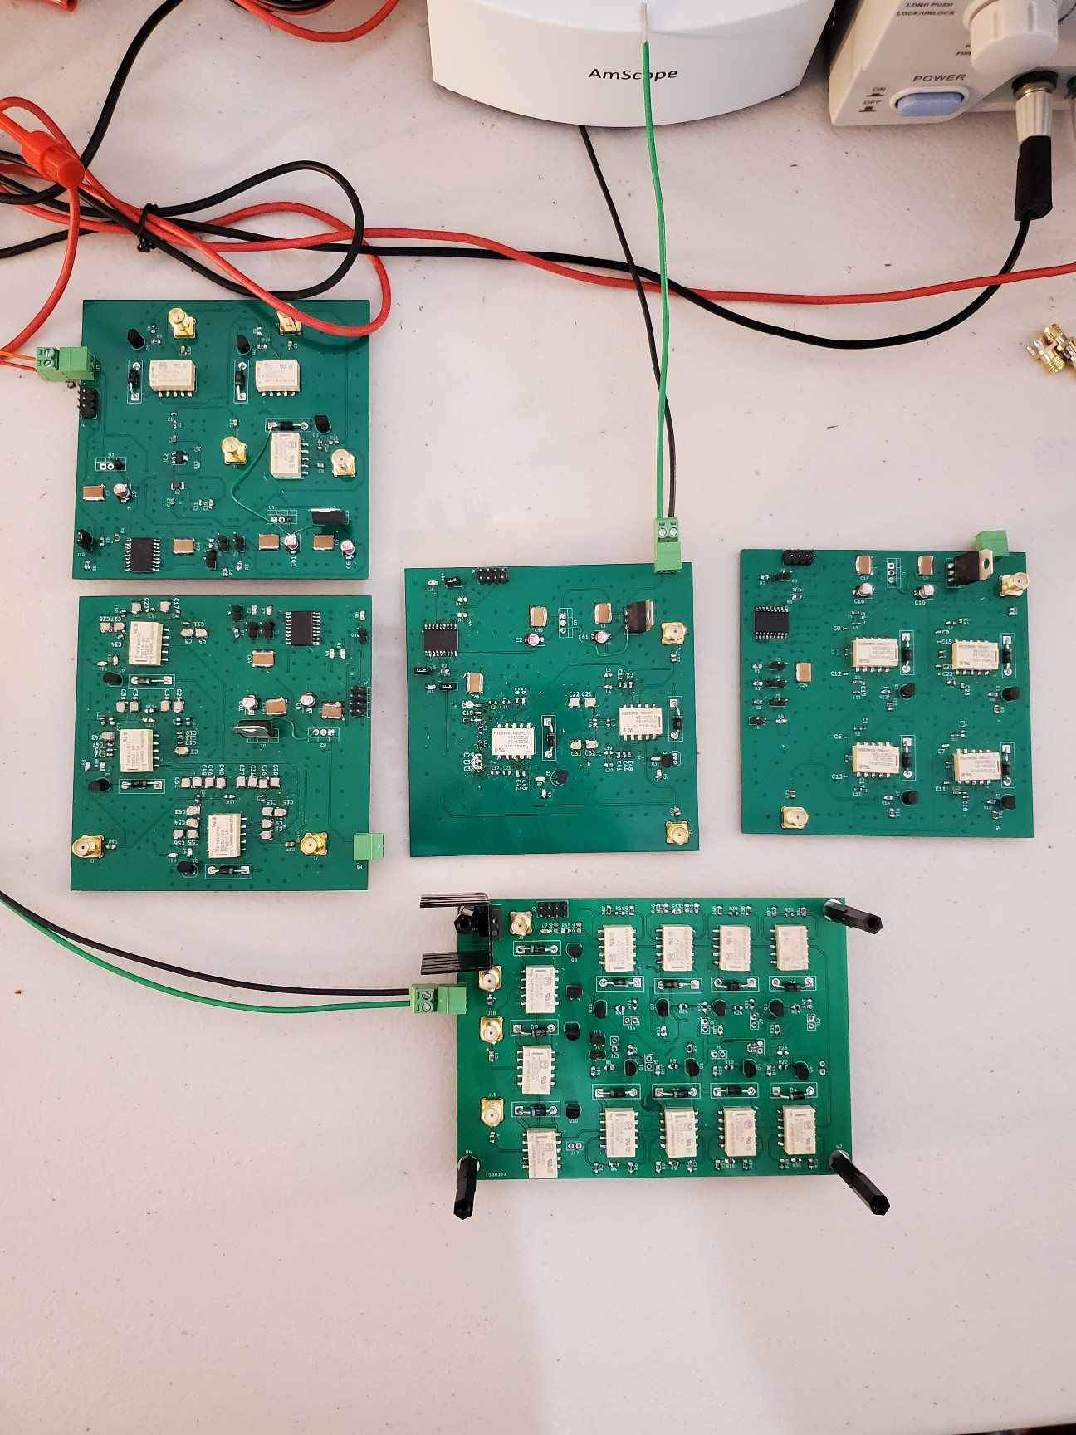



Subsystem 4
Filter boards
Attenuator board
Amplifier board

Slide 22
Demo Video
Video Demonstrating basic integration of subsystems 1, 2 and 3: https://youtu.be/LLt8P8SsYCI

Slide 23
Thank You

Slide 24
Questions

